Slide 1

Jenkins
- Mini Project -

Slide 2
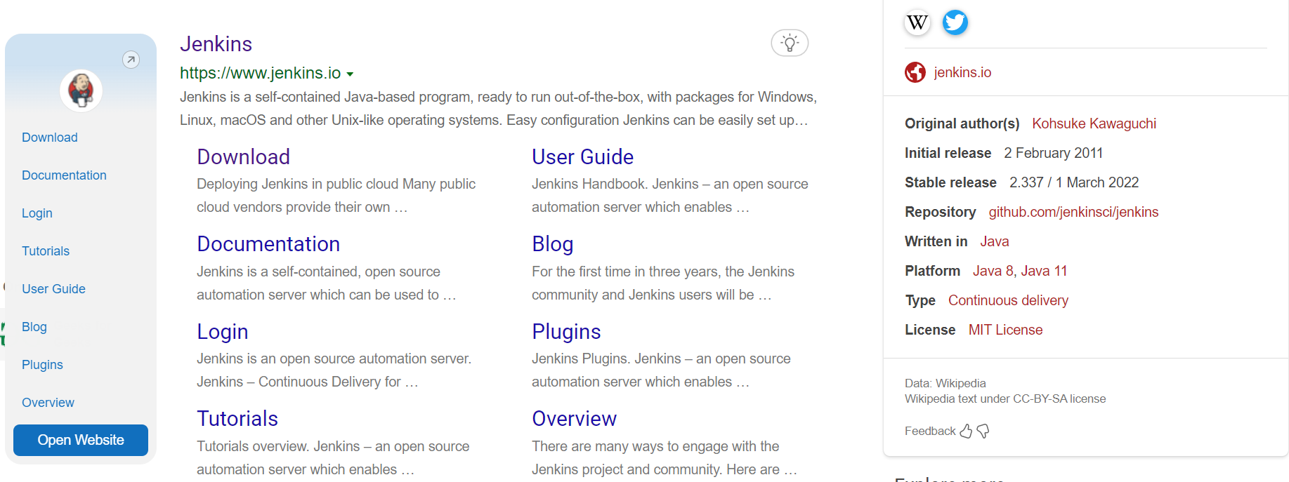
Open browser and search Jenkins

Slide 3
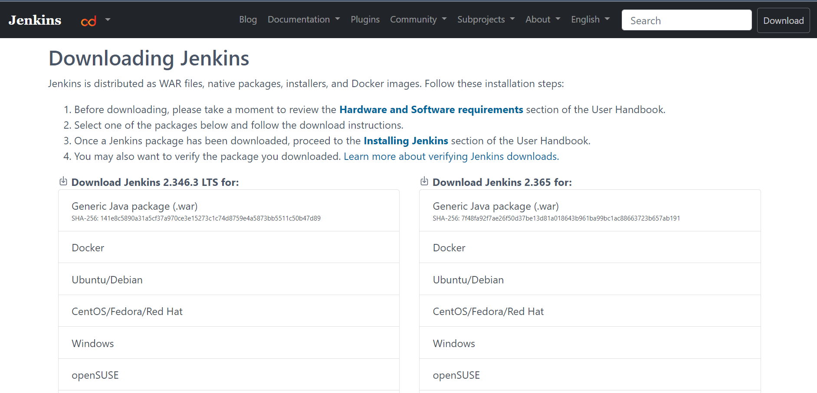
DOWNLOAD

Slide 4
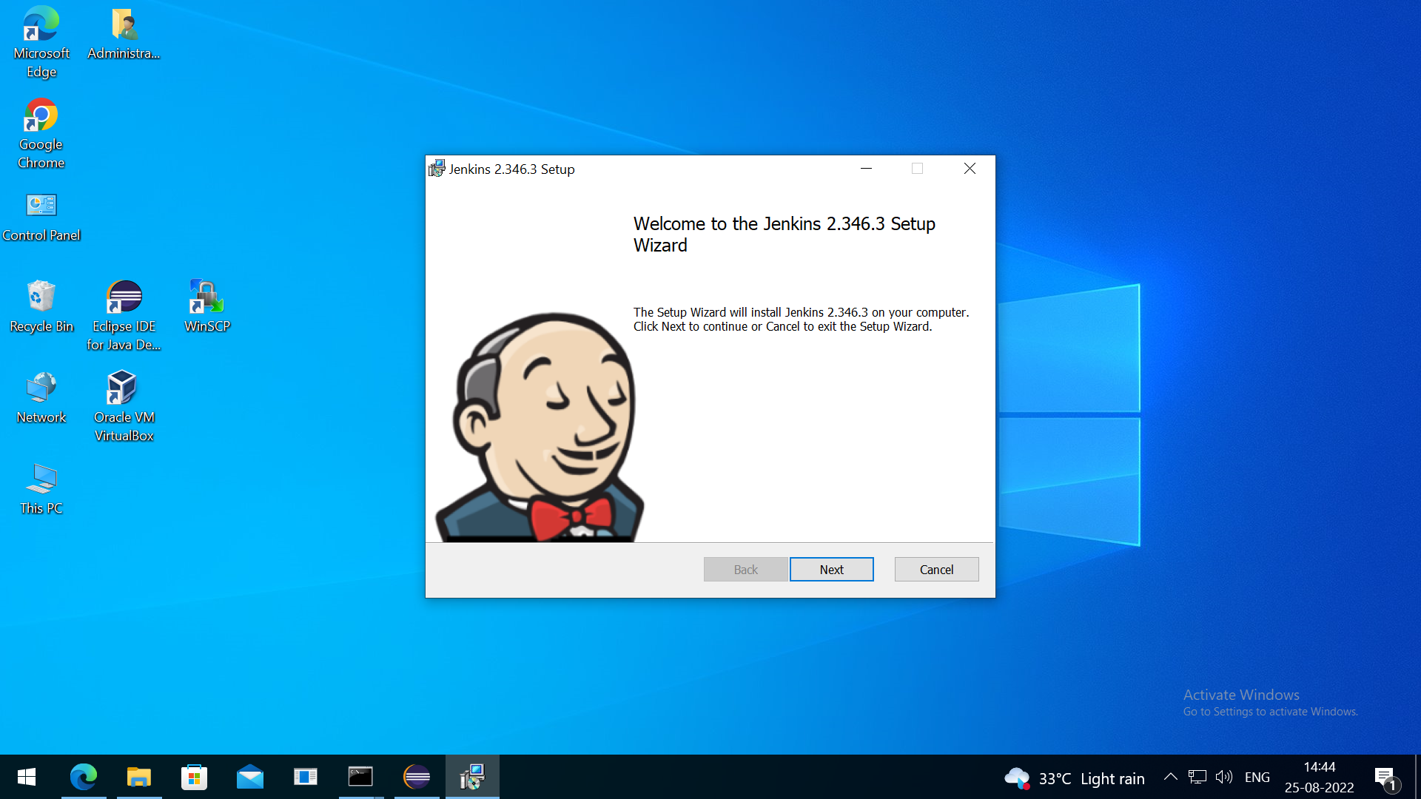
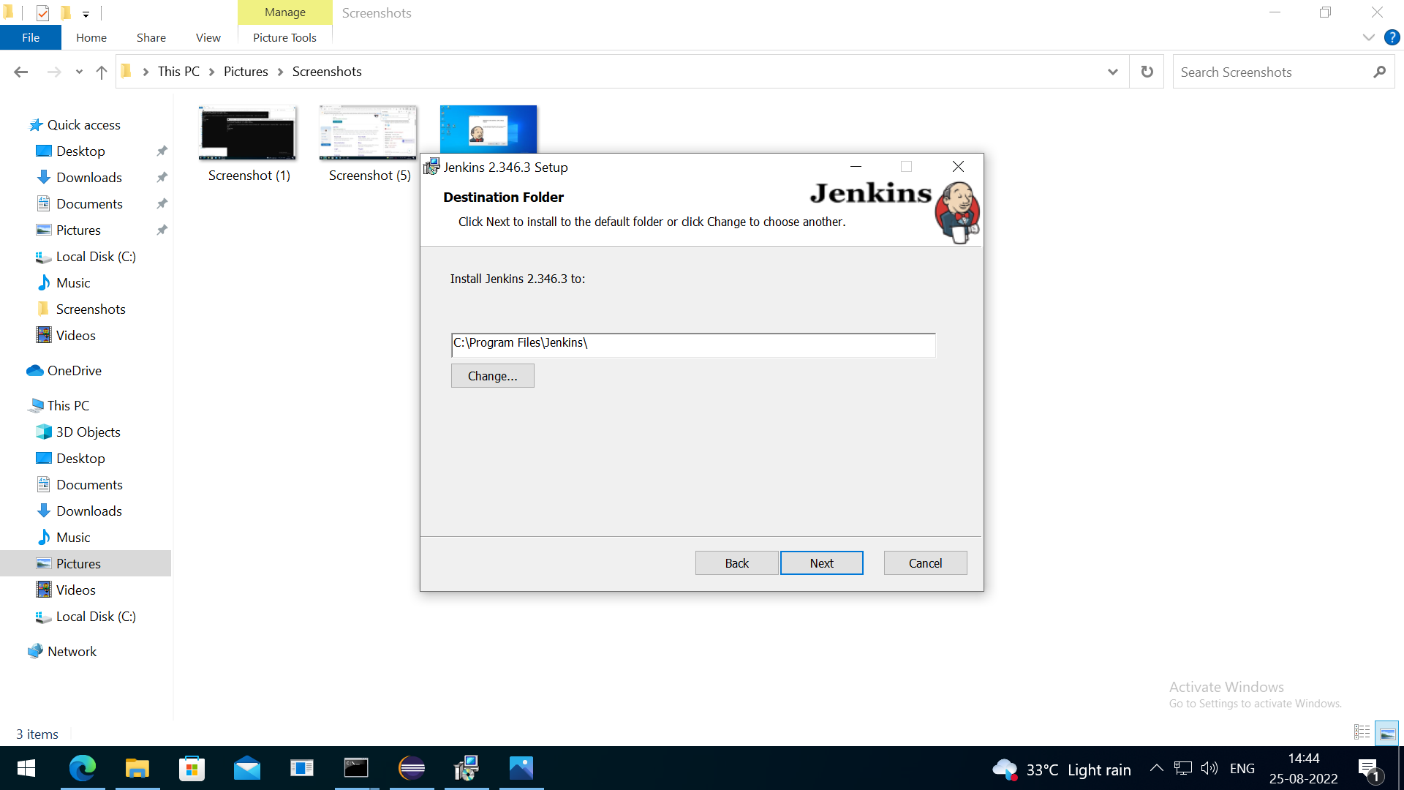
INSTALLATION
Set Path for Jenkins

Slide 5
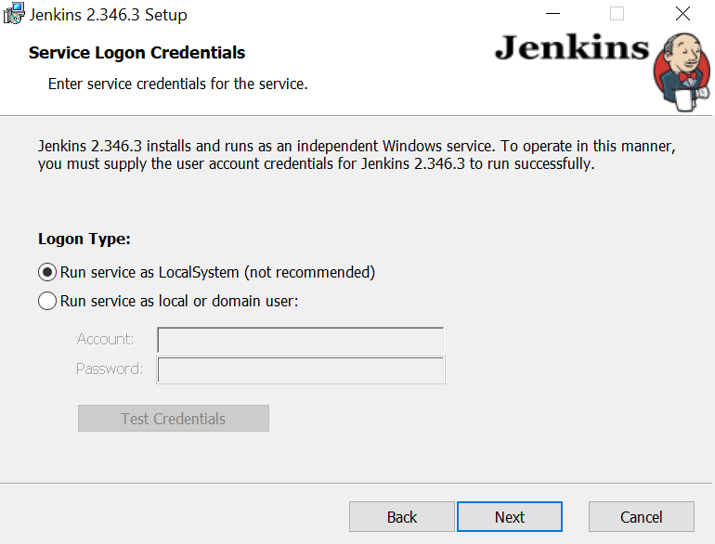
Choose the Logon Type: Run service as LocalSystem

Slide 6
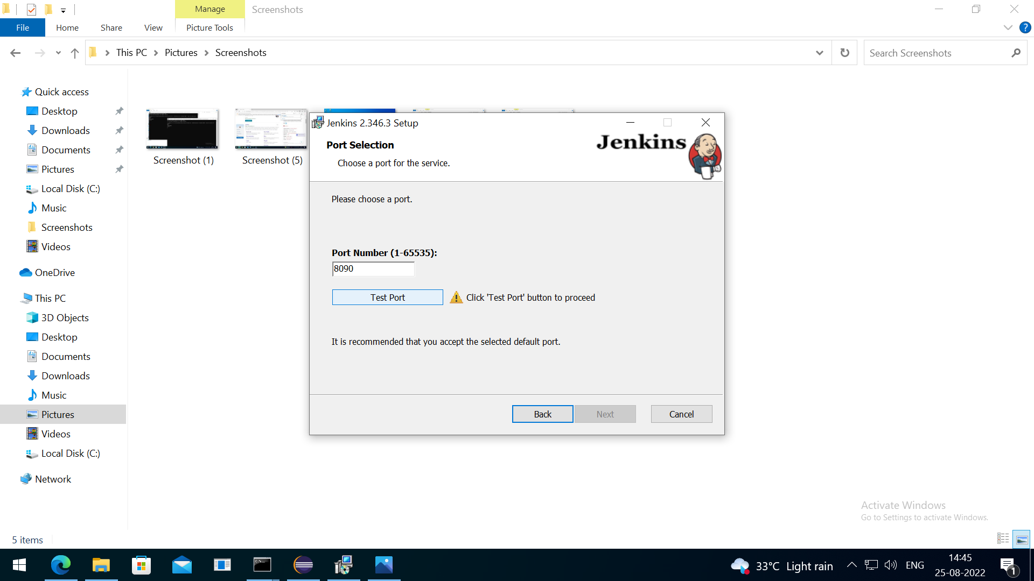
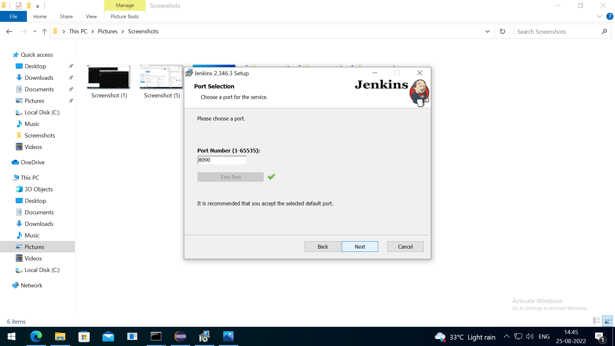
Choose and Test Port for the service

Slide 7
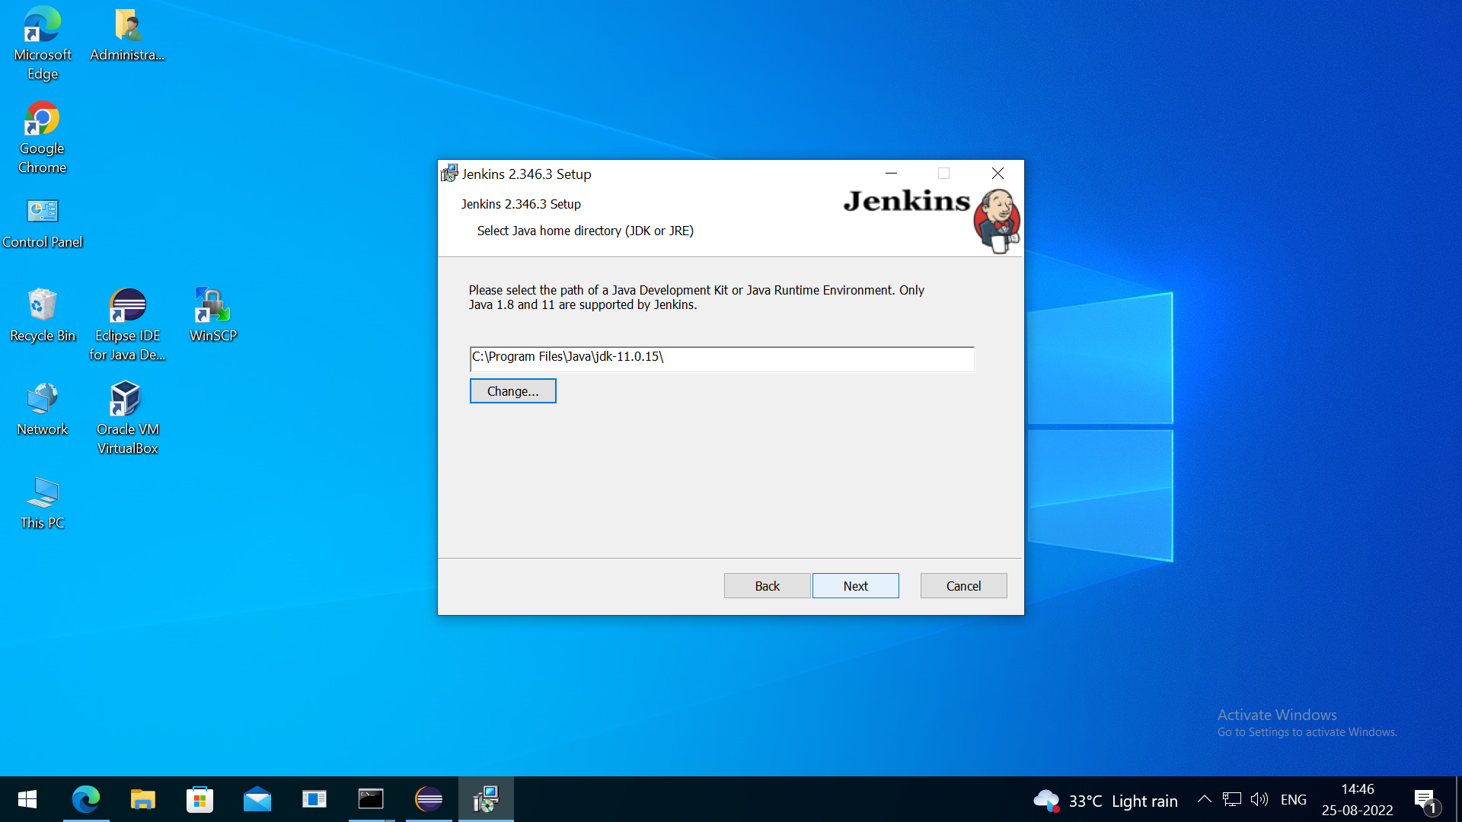
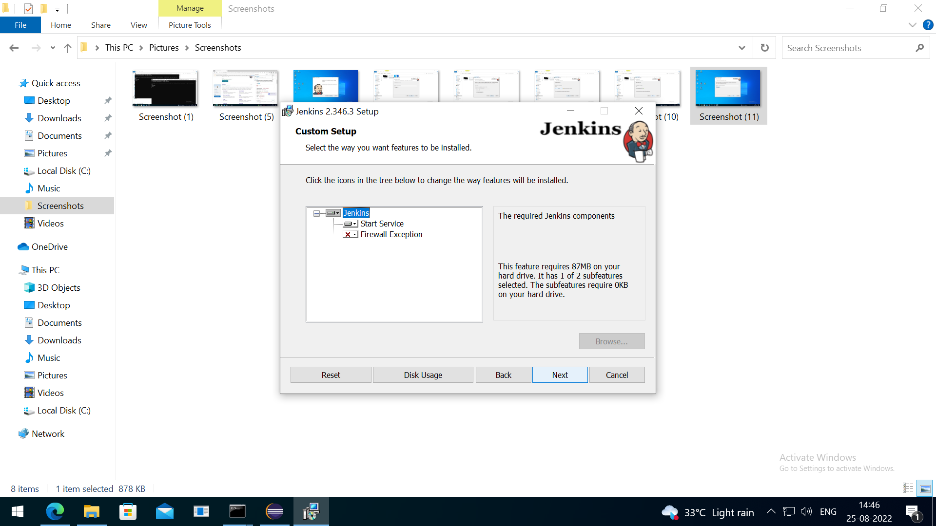
Choose the path of JDK supported by Jenkins

Slide 8
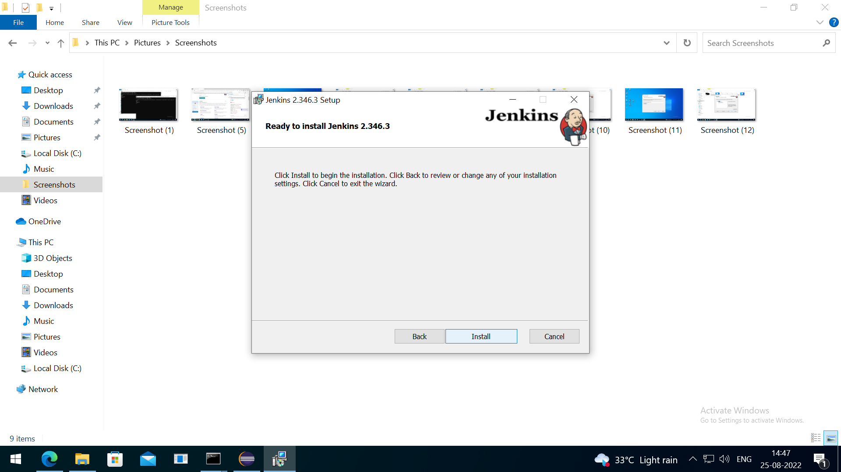
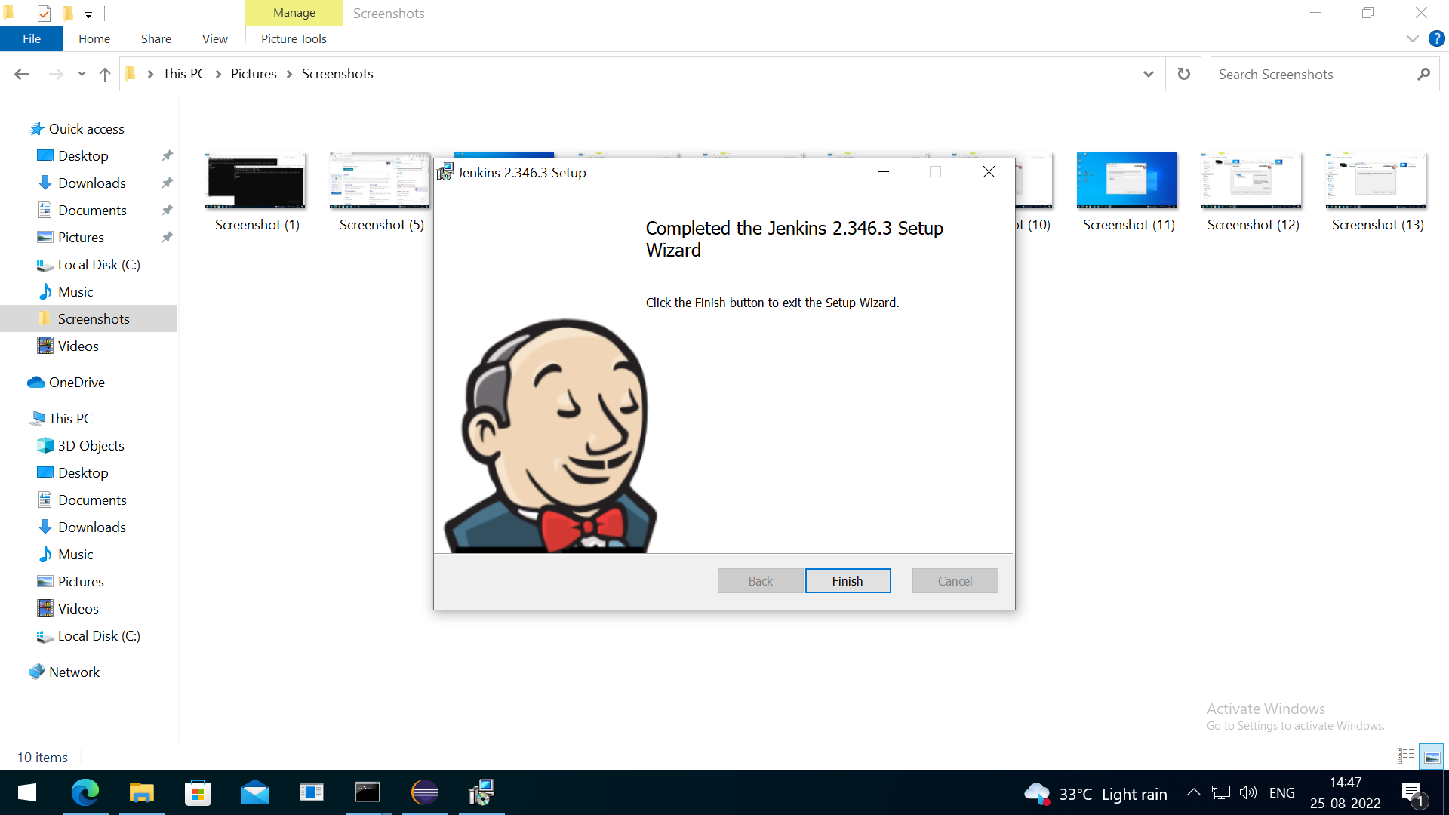
Click Install and Finish

Slide 9
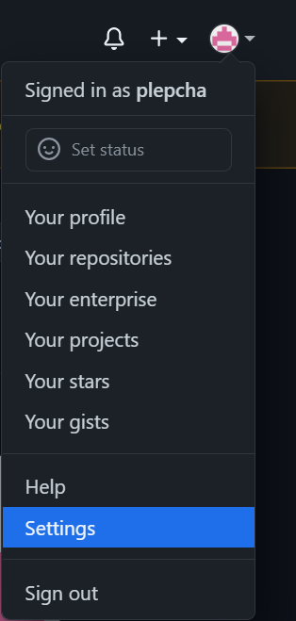
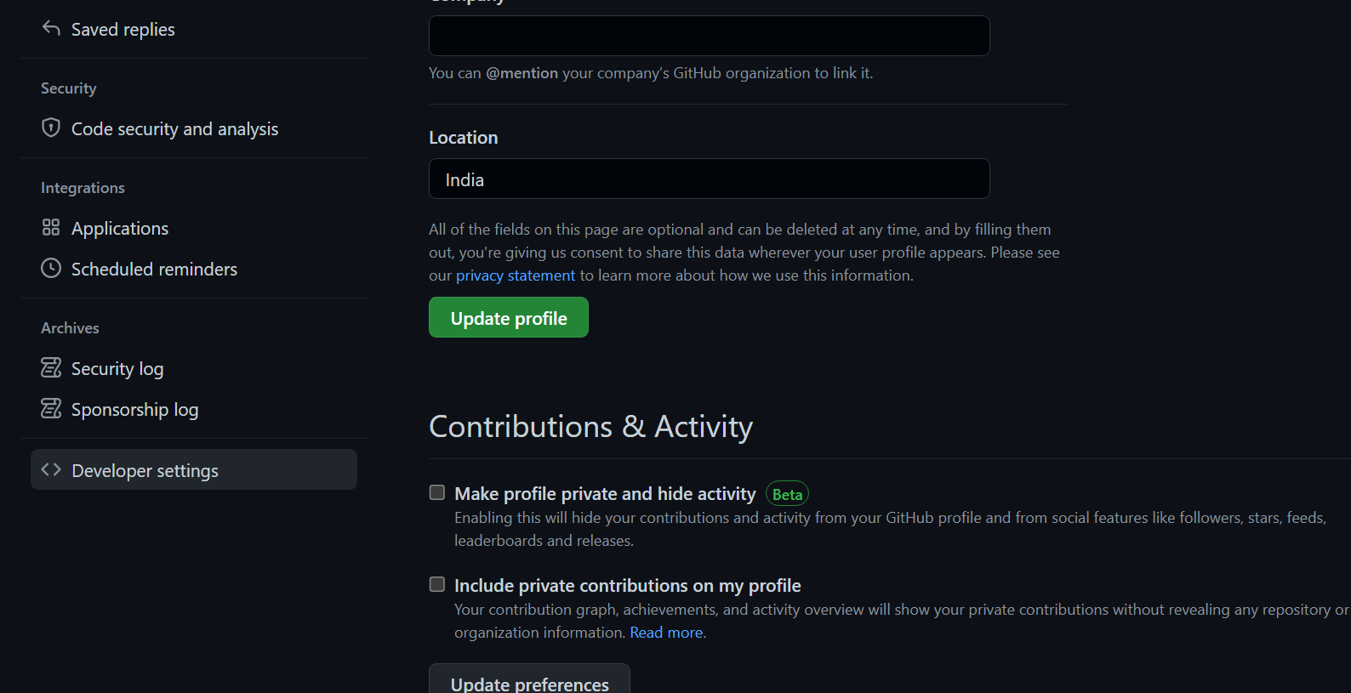
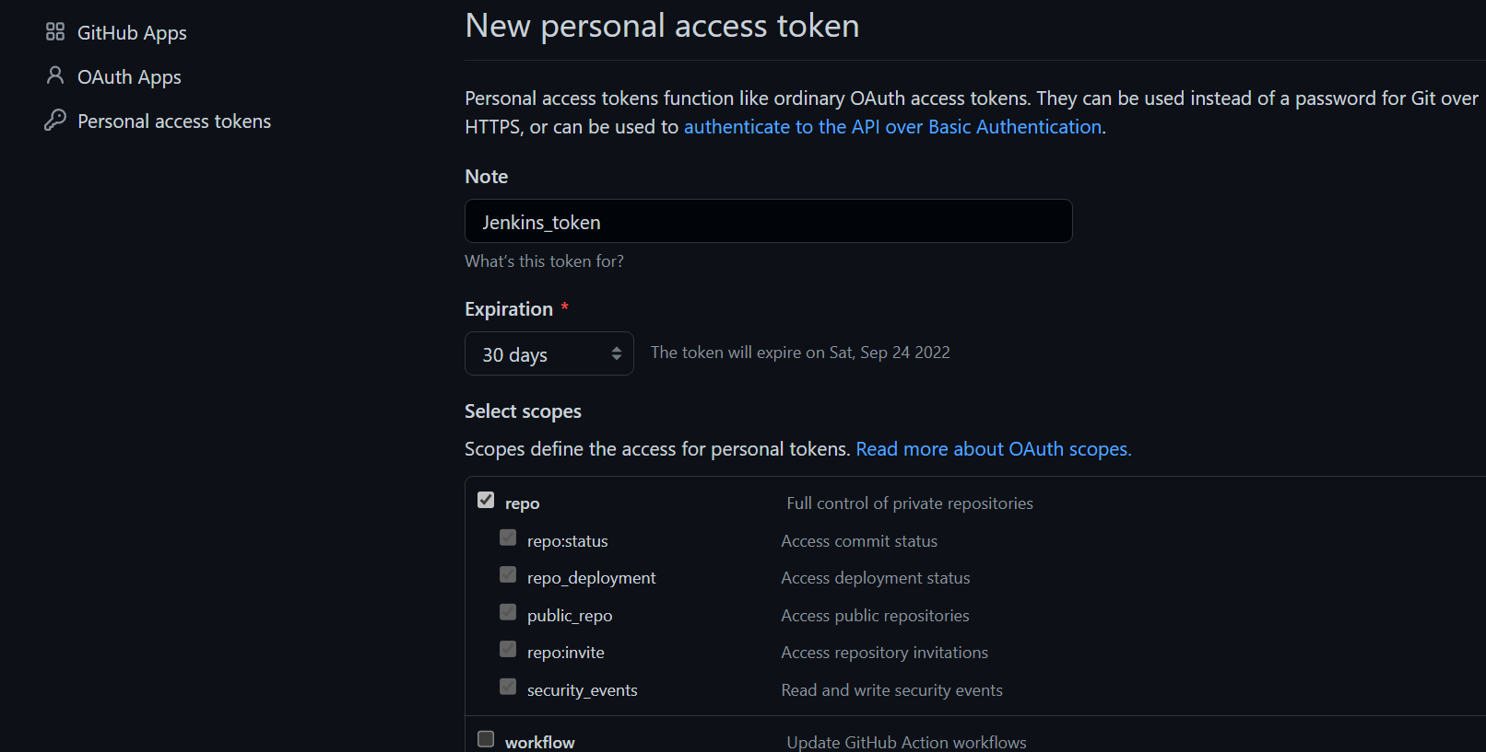
GENERATING ACCESS TOKEN
Go to GitHub Settings
Developer settings
Personal access tokens

Slide 10
Name the Access token

Slide 11
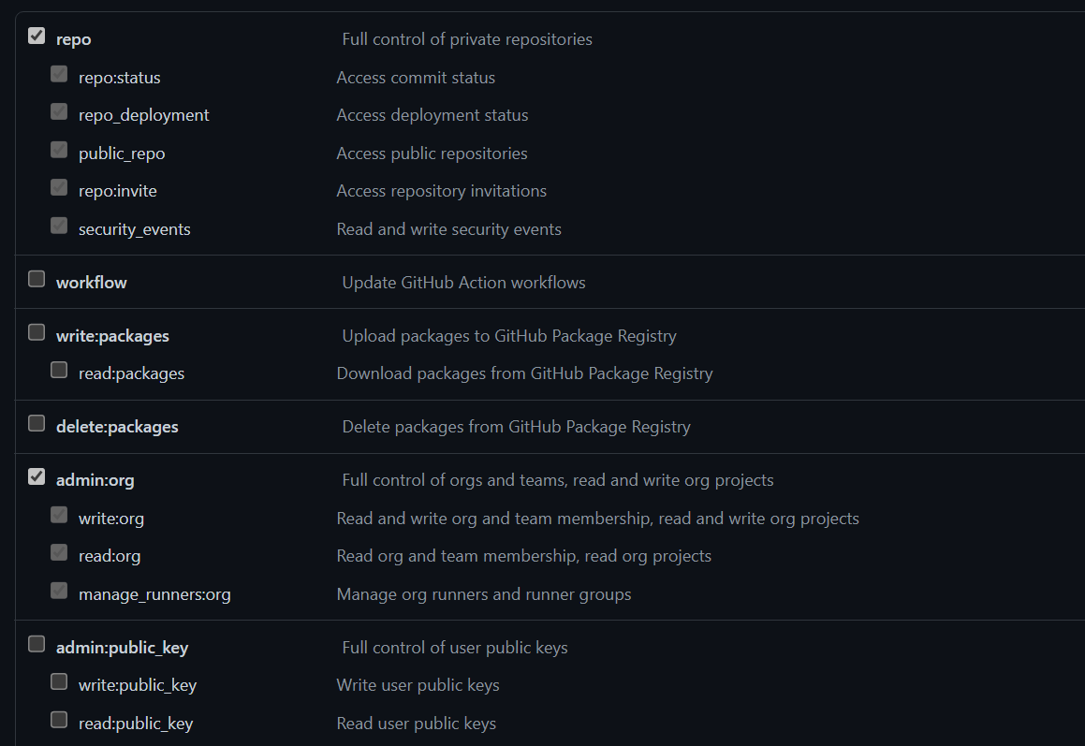
Define the access for personal access token

Slide 12
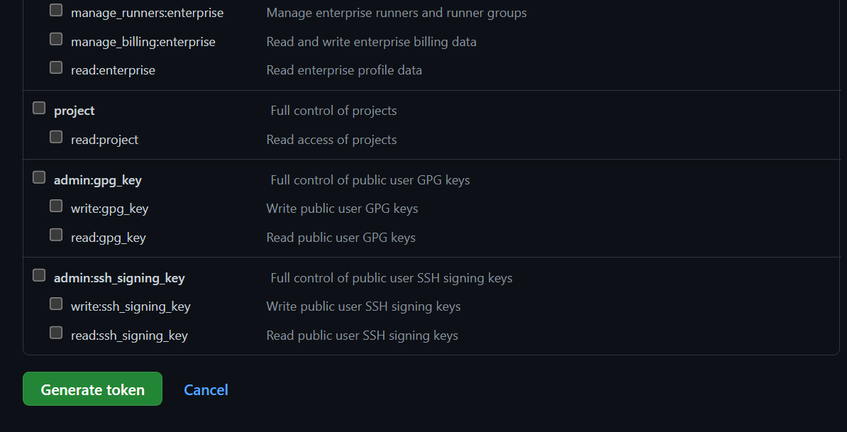
Click Generate token

Slide 13
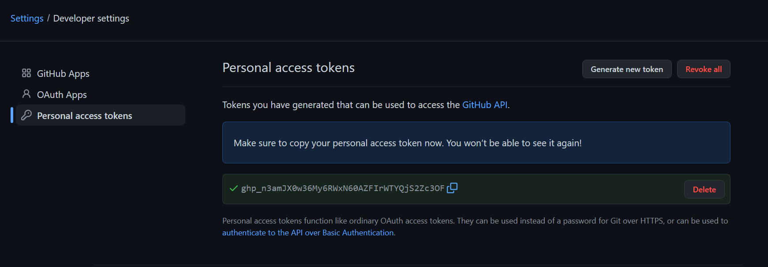
Copy and save the access token
******

Slide 14
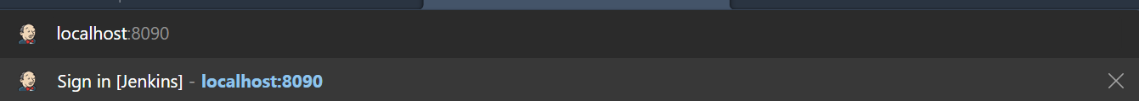
STARTING WITH JENKINS
Go to your browser and type localhost:< your port number >

Slide 15
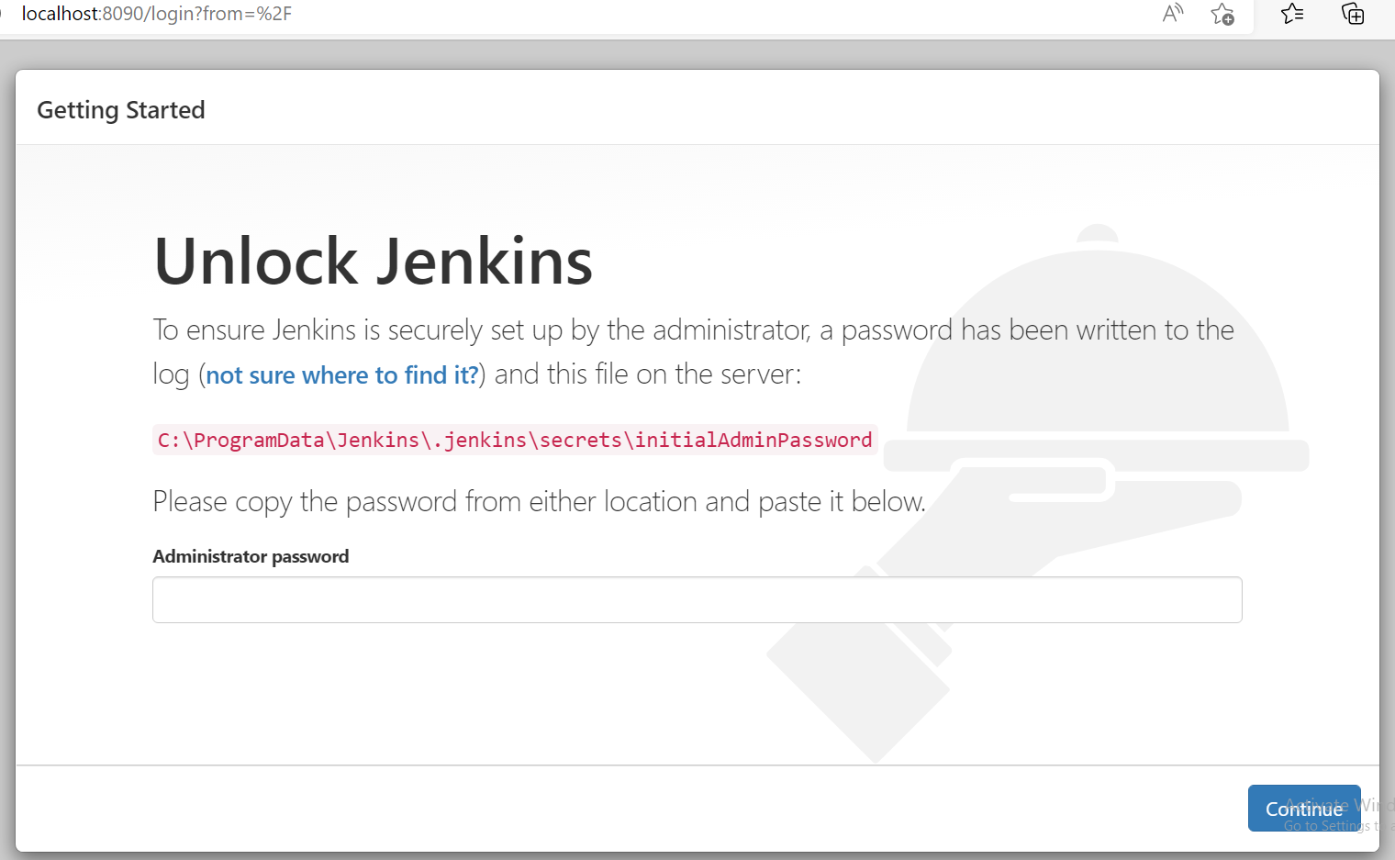
Go to the path and copy the Administrator password

Slide 16
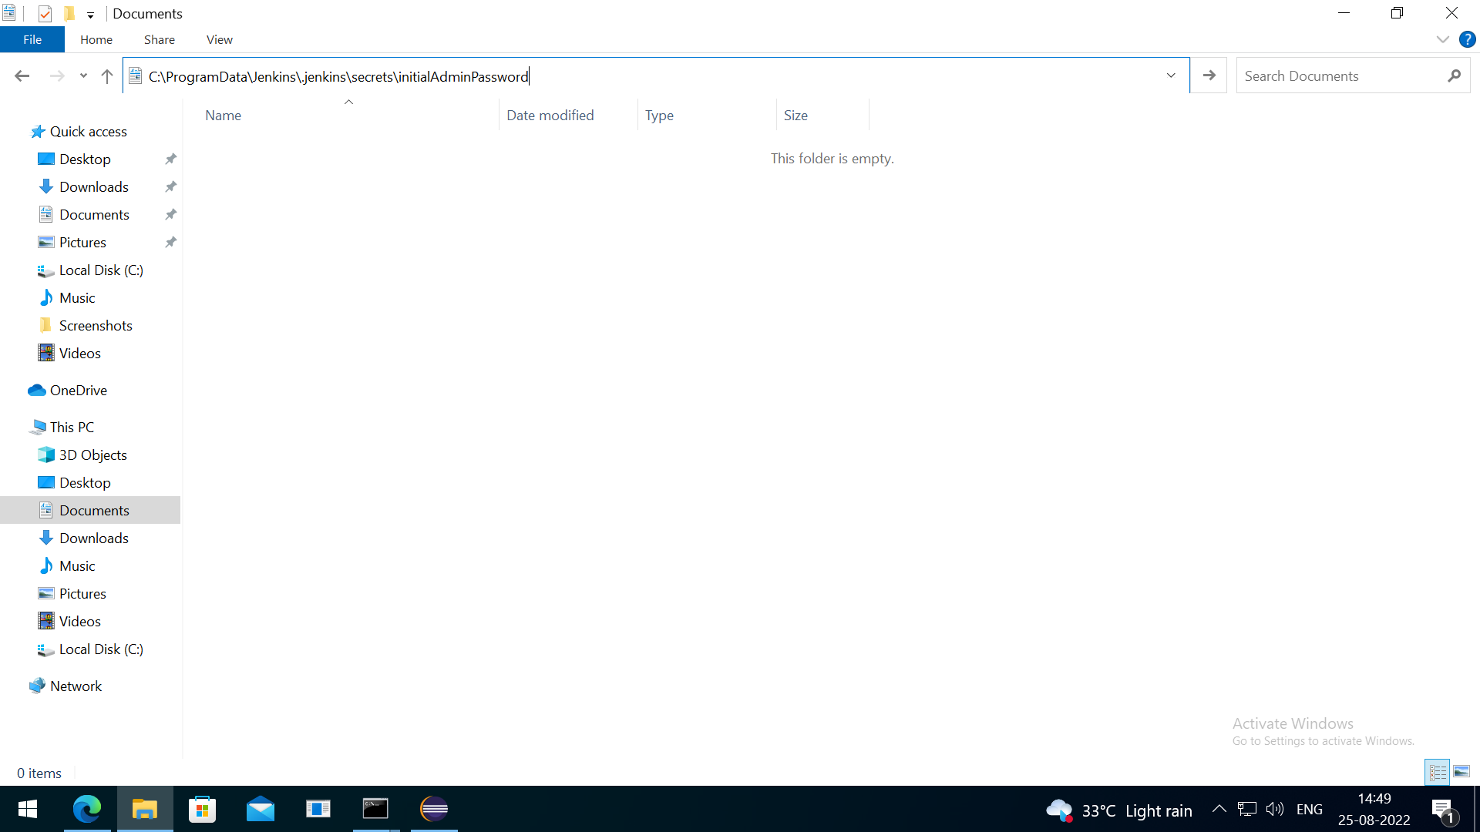
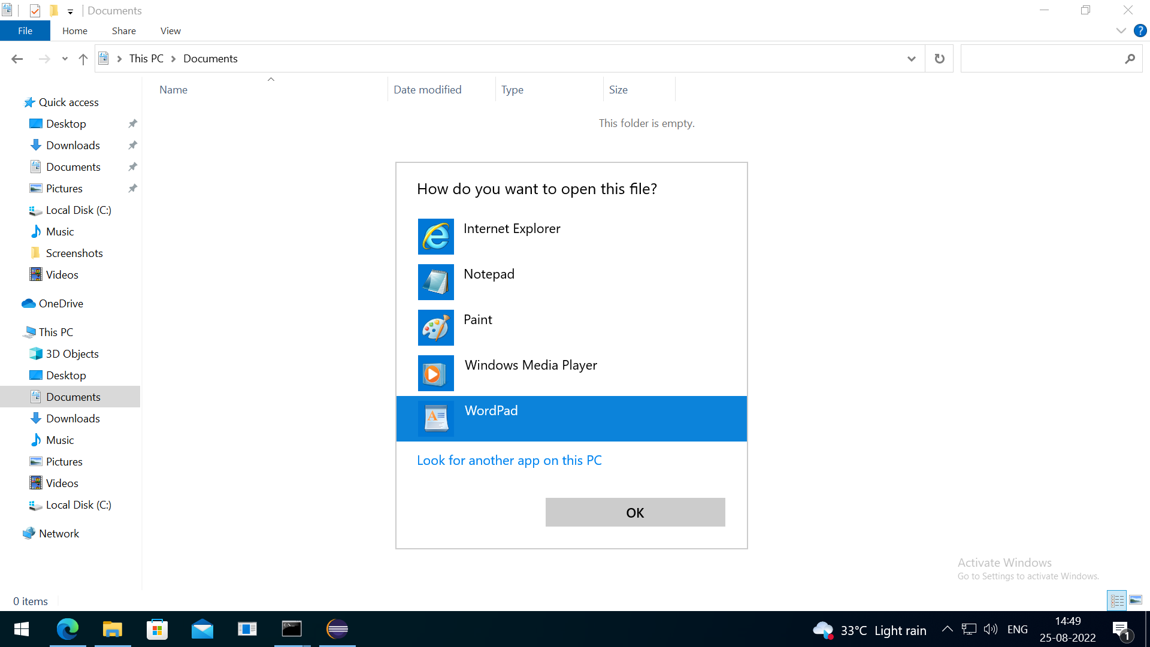

Slide 17
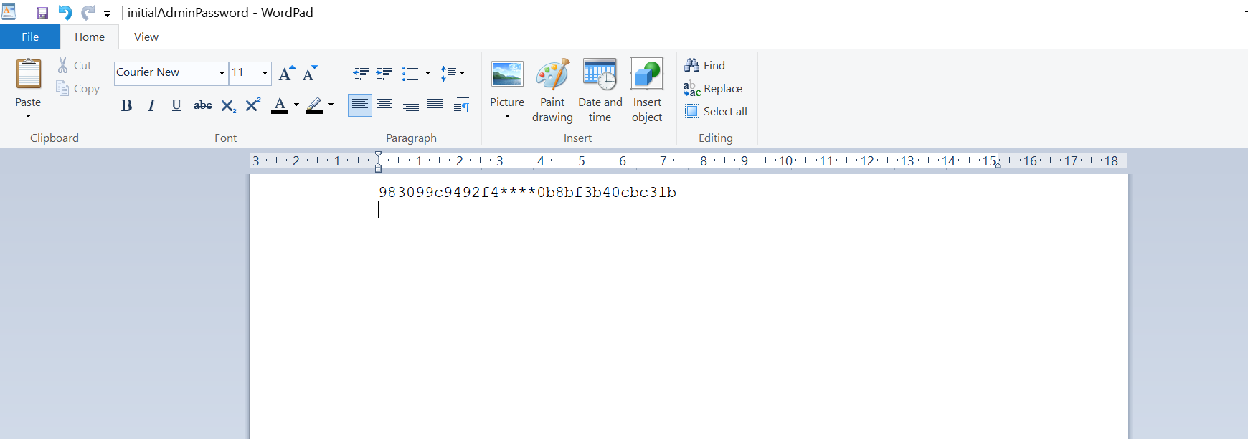
Copy the password and paste to unlock Jenkins

Slide 18
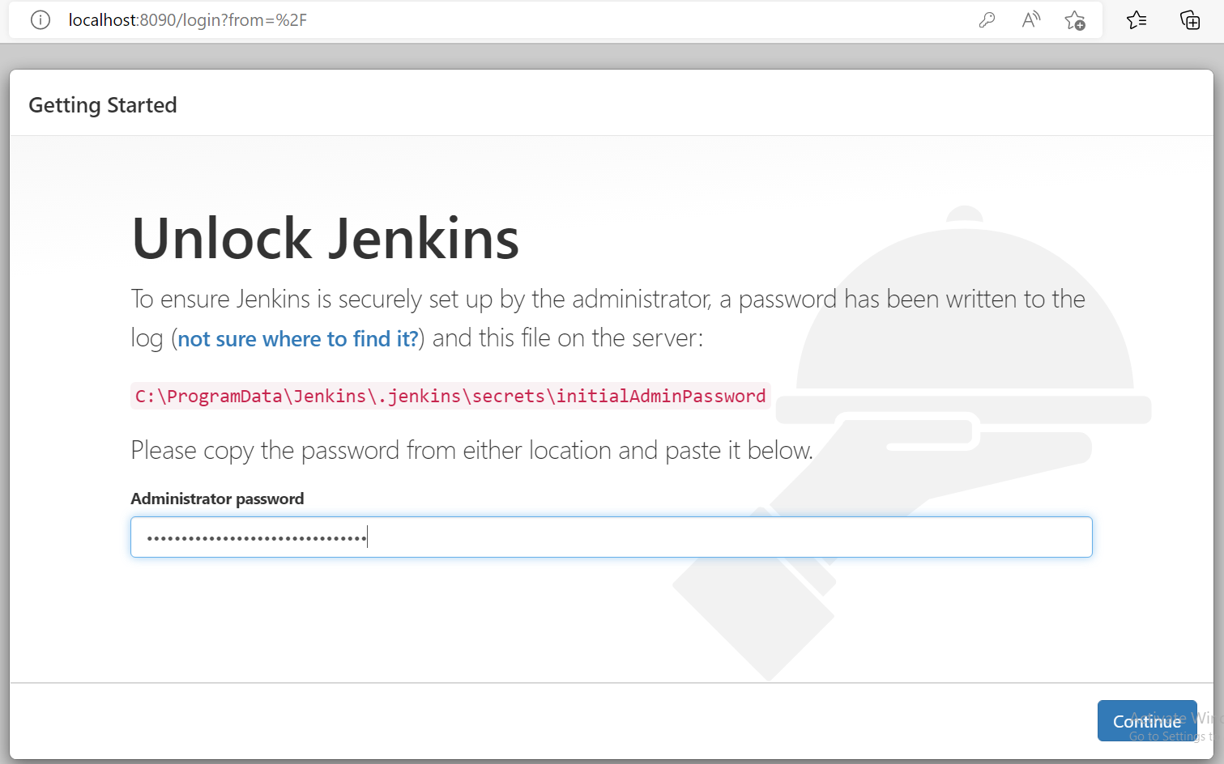

Slide 19
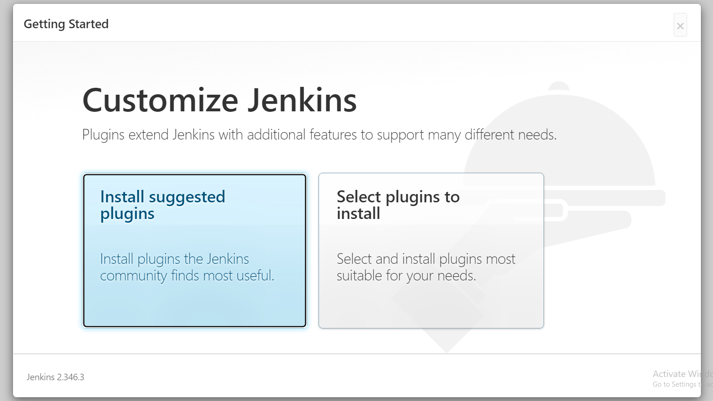
Click on Install suggested plugins

Slide 20
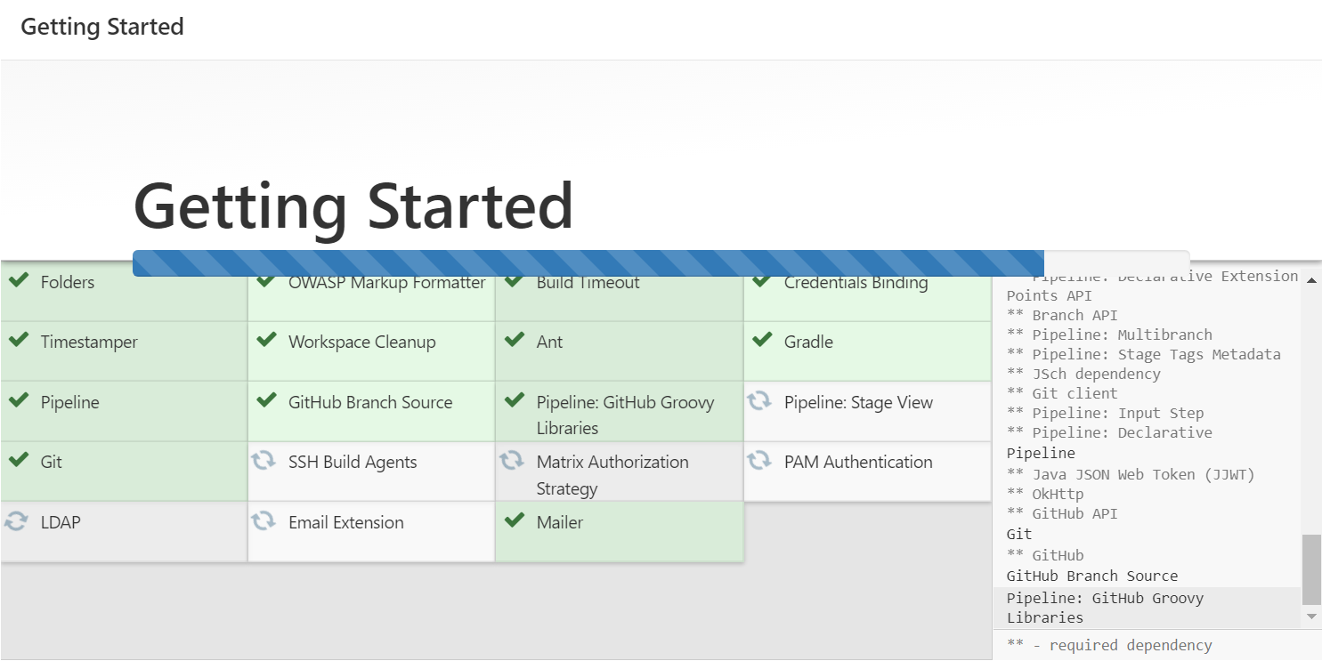

Slide 21
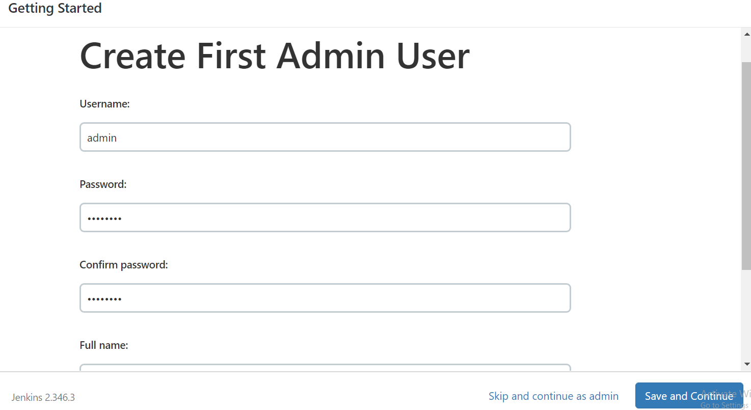
Fill your details and click ‘Save and Continue’

Slide 22
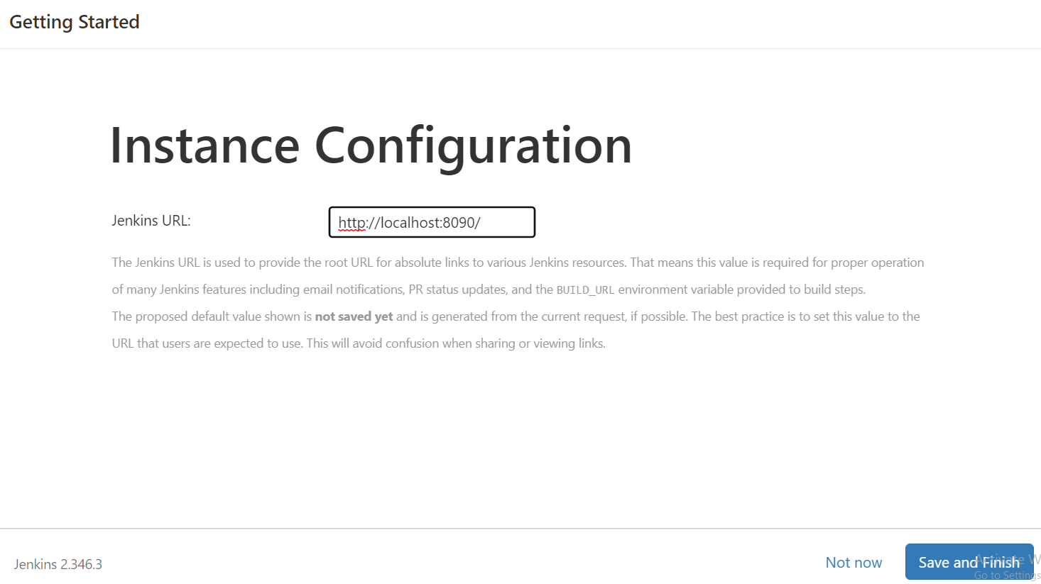

Slide 23
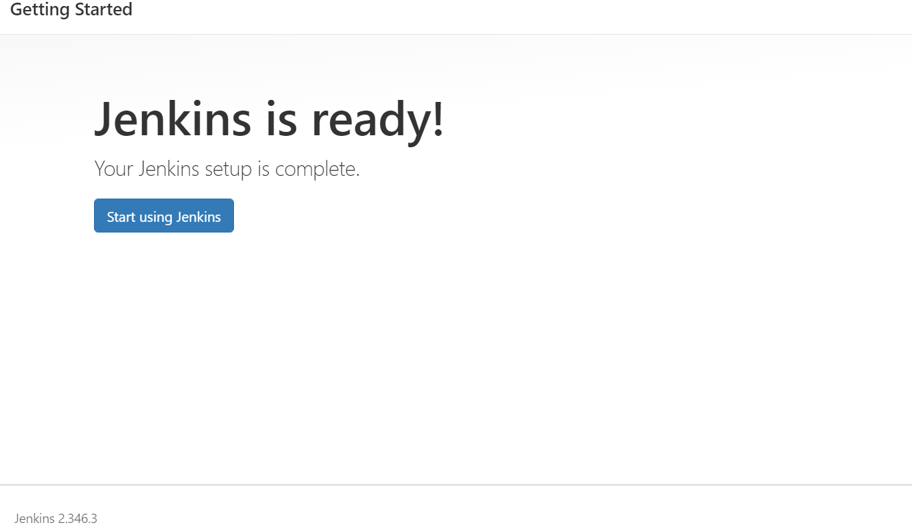
Your Jenkins is ready to use!

Slide 24
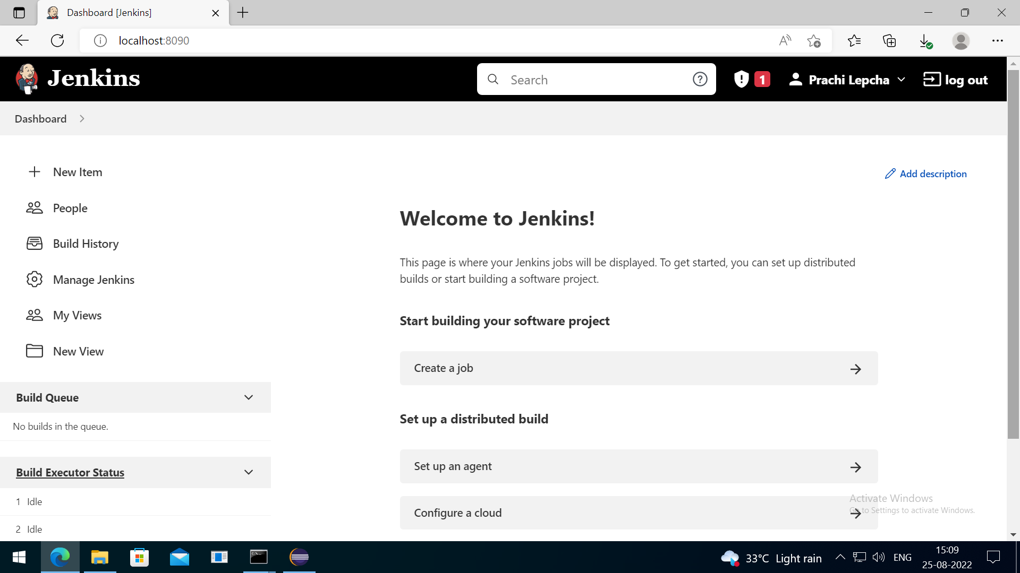
Jenkins Dashboard

Slide 25
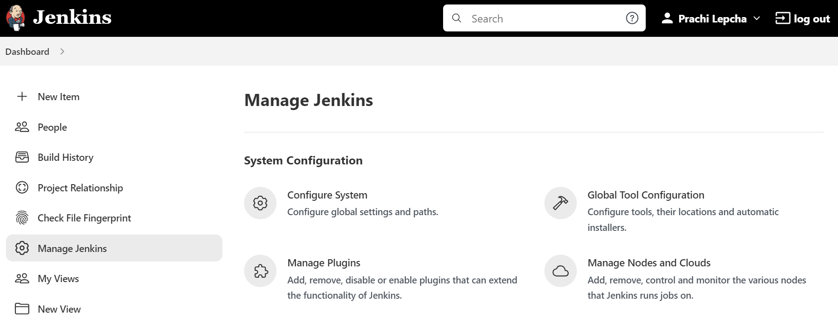
Go to Manage Jenkins for setting configurations

Slide 26
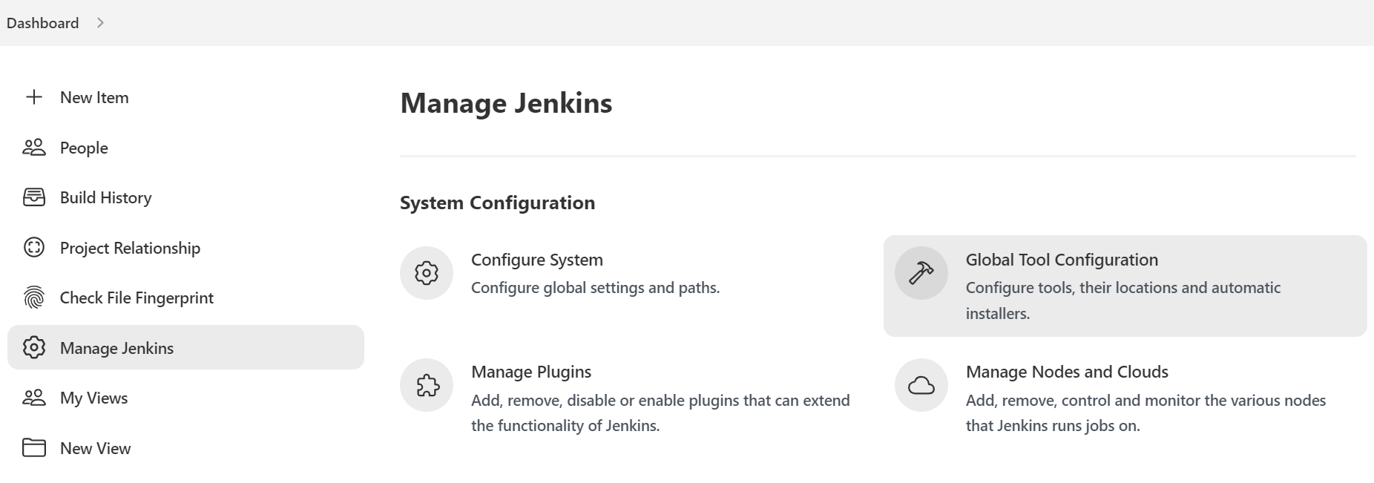
Go to Global Tool Configuration

Slide 27
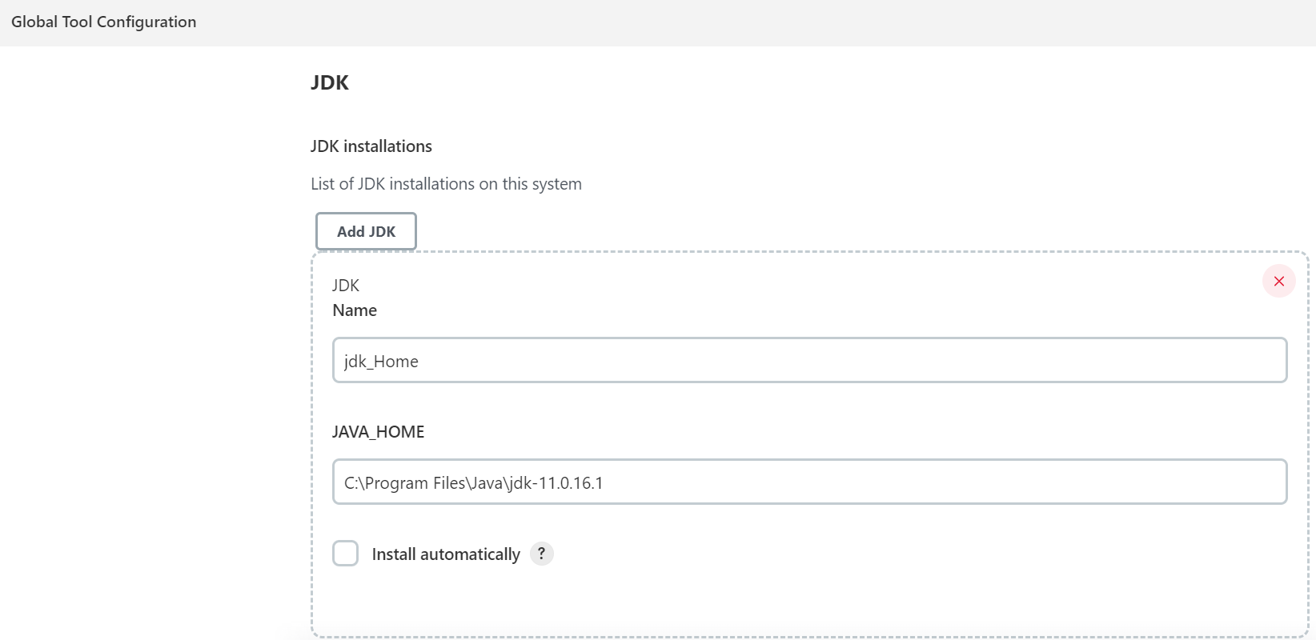
Setting path of JDK for Jenkins

Slide 28
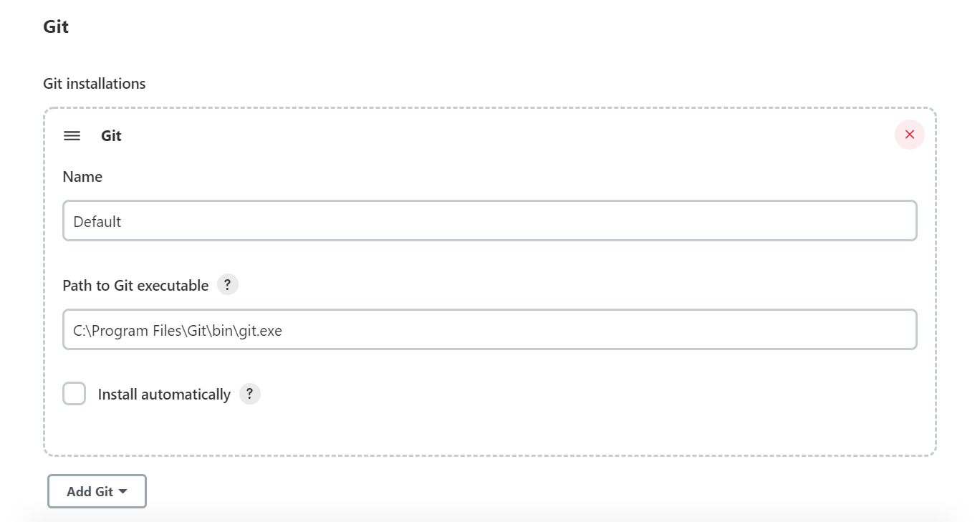
Setting path of Git for Jenkins

Slide 29
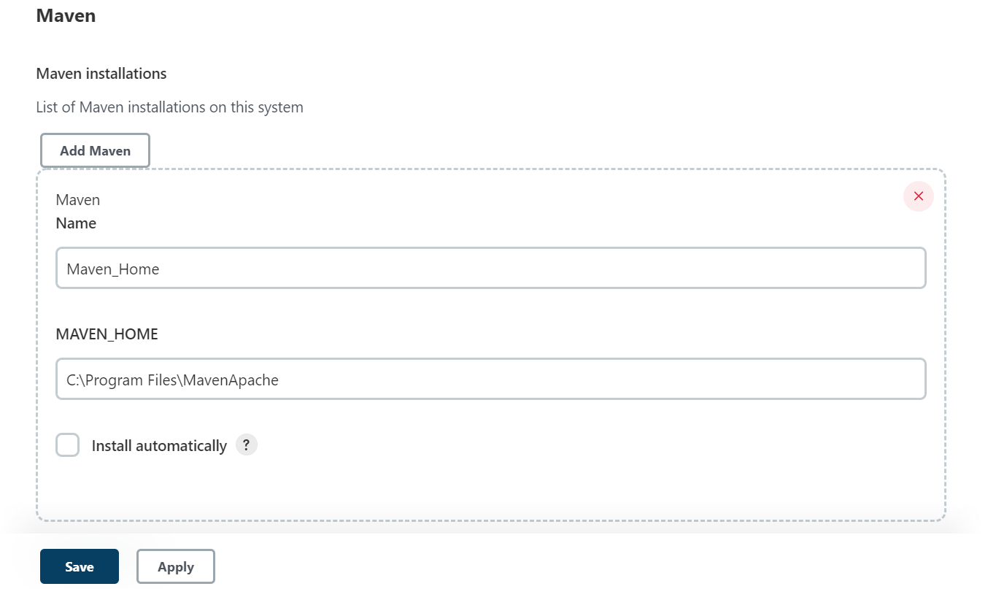
Setting path of Maven for Jenkins
Click Apply and Save

Slide 30
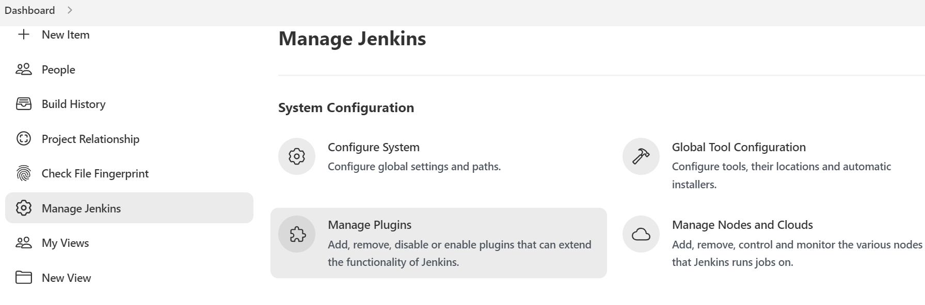
Go to Manage Plugins to install or uninstall plugins

Slide 31
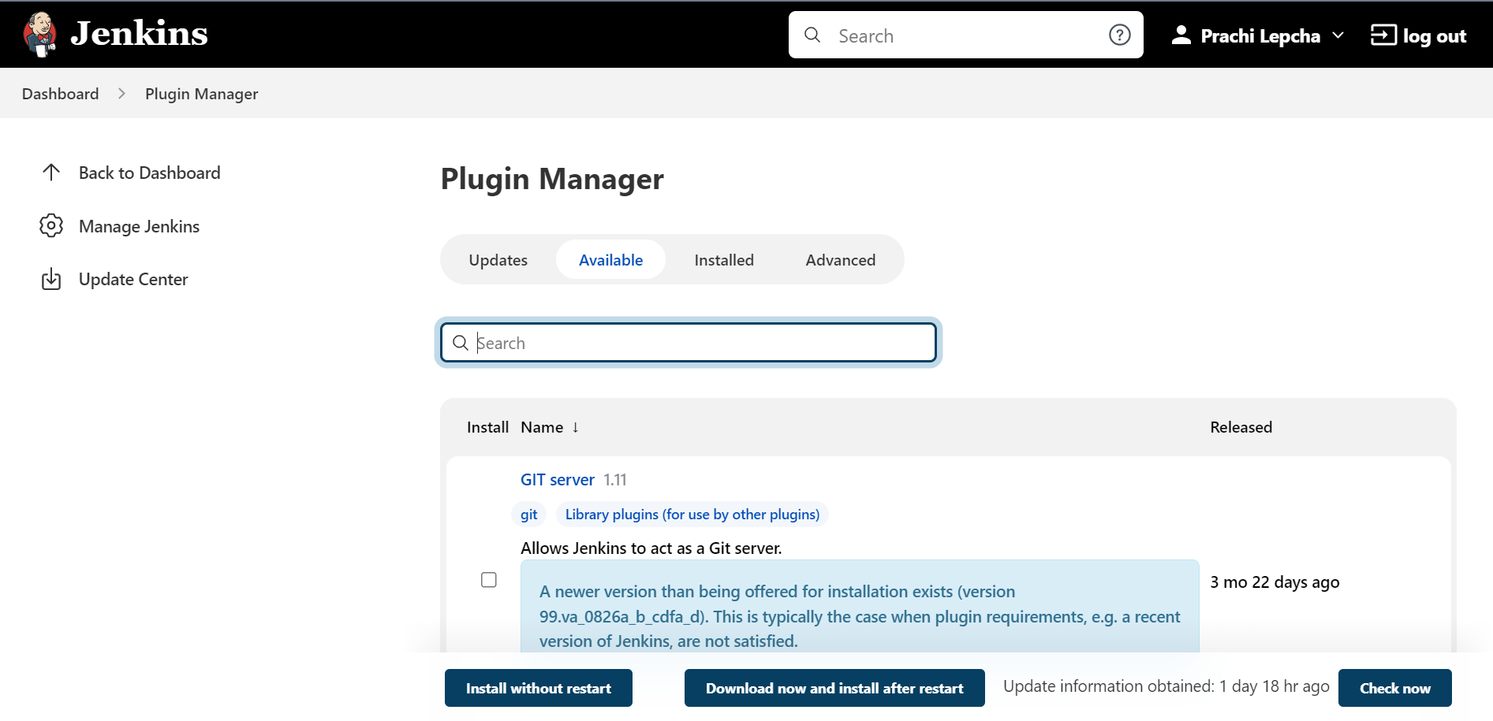

Slide 32
Go to New Item to build a job

Slide 33
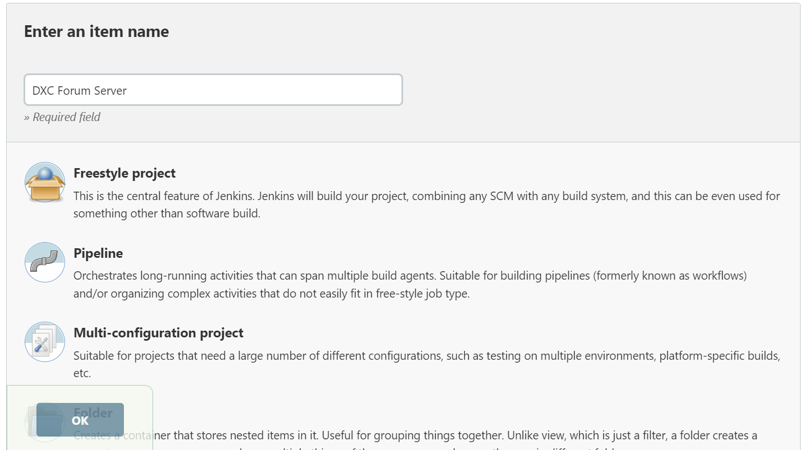
Enter the name

Slide 34
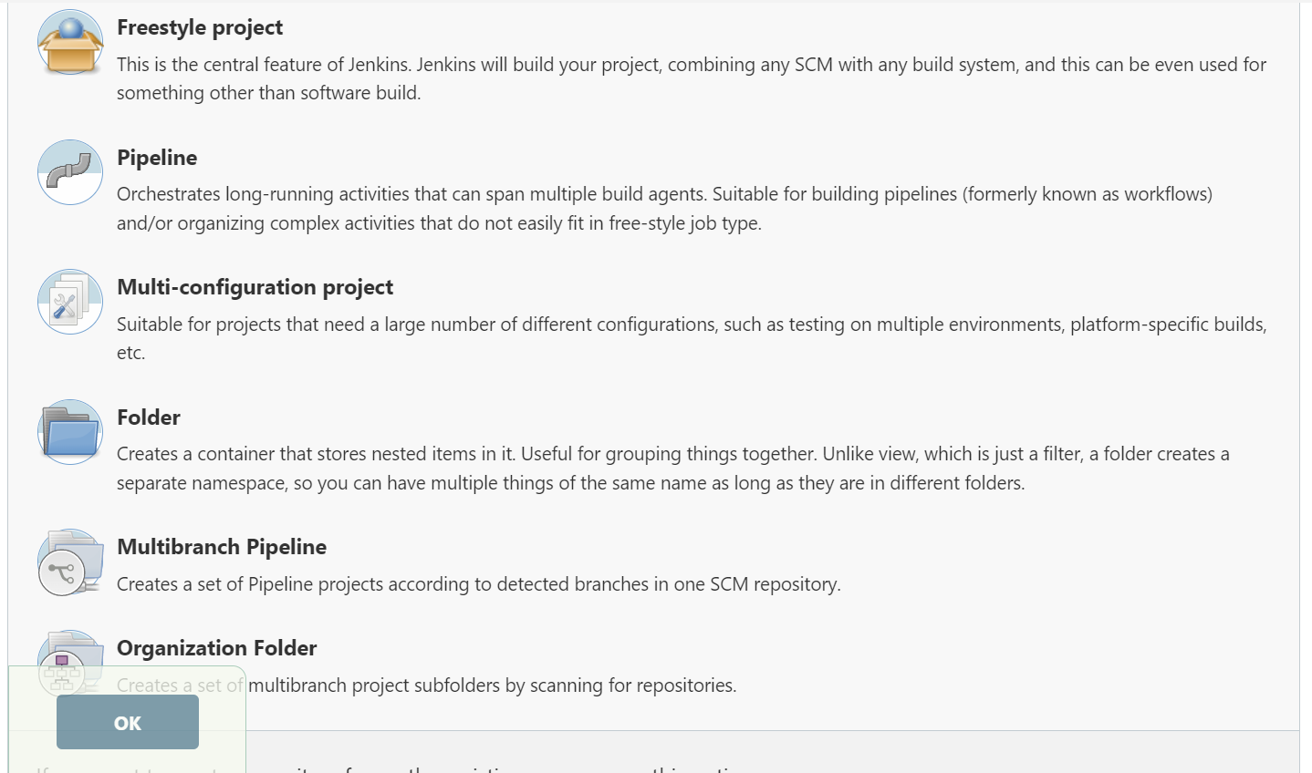
Select any Jenkins job according to your project and click the OK button

Slide 35
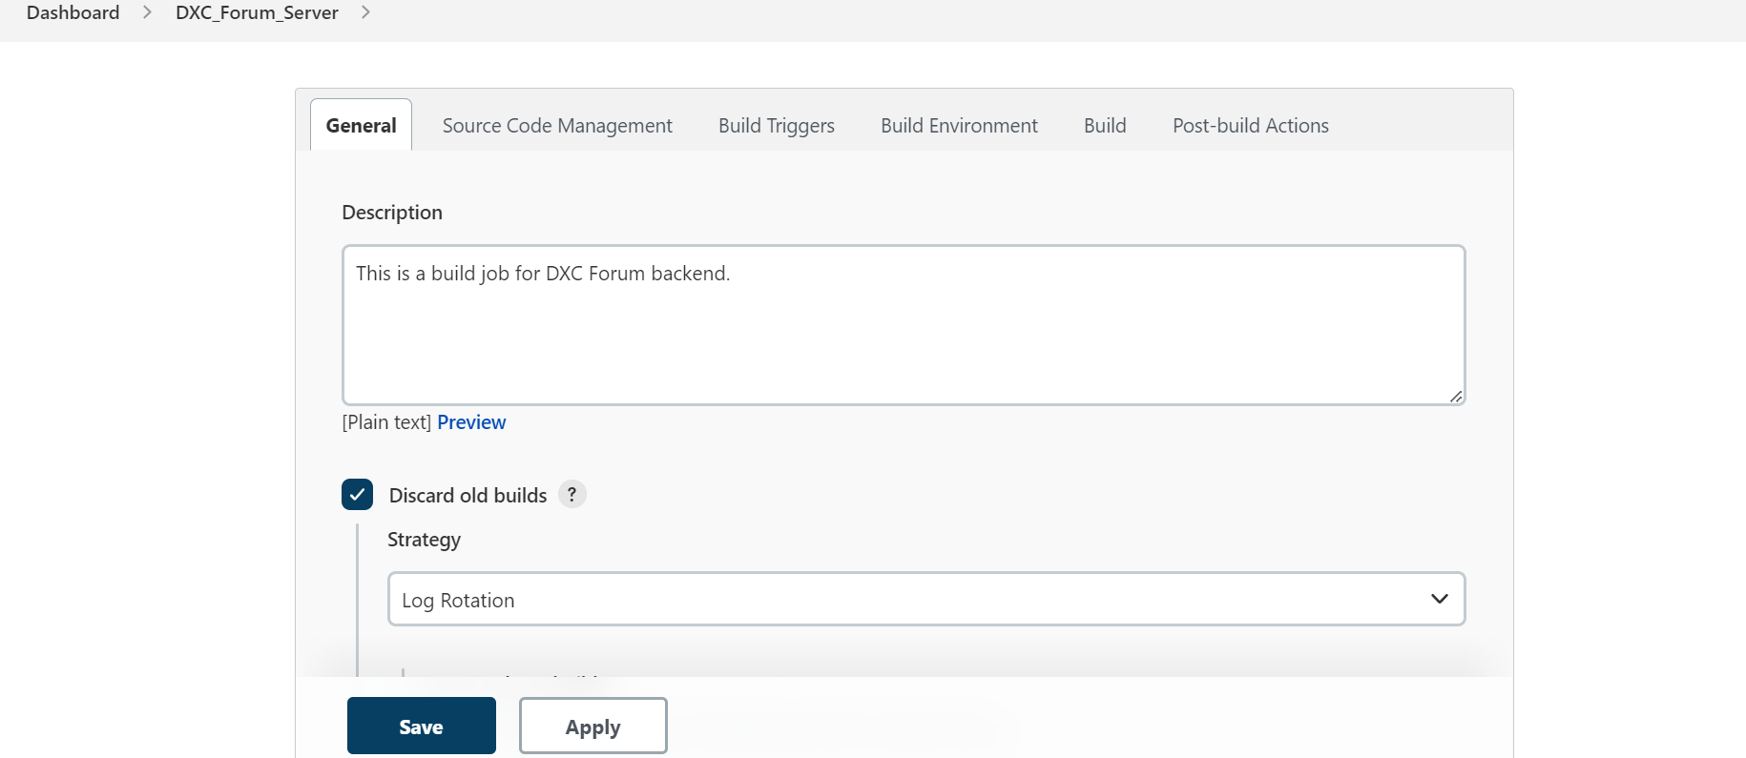
BUILD JOB FOR BACK-END
Specify the details of your project

Slide 36
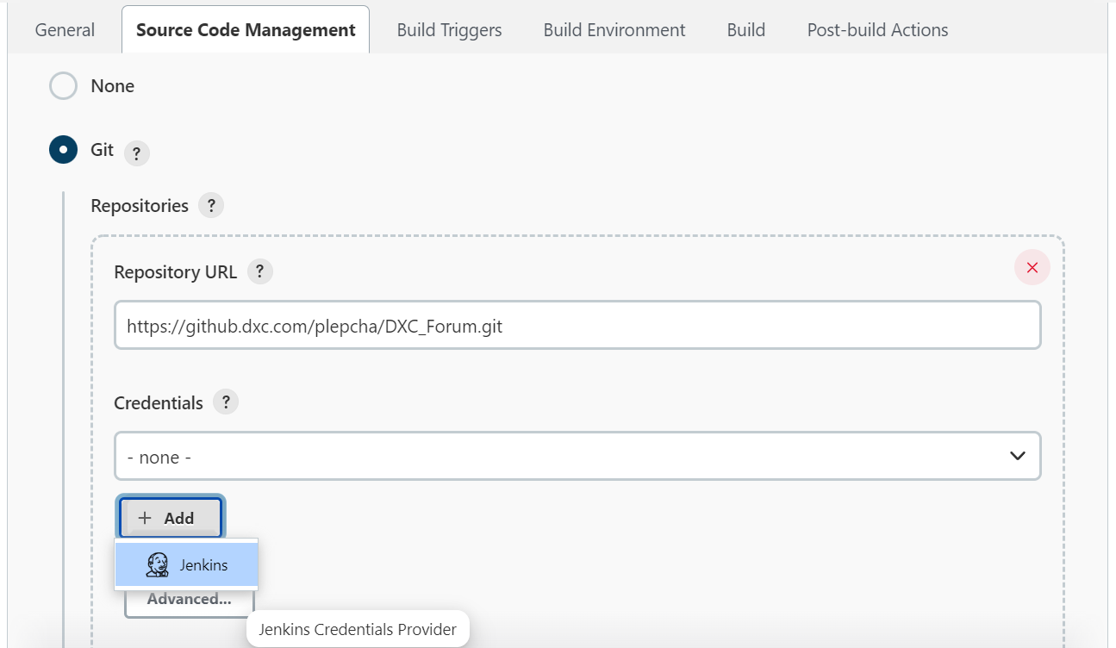
Connecting to Git : Give repository URL and credentials

Slide 37
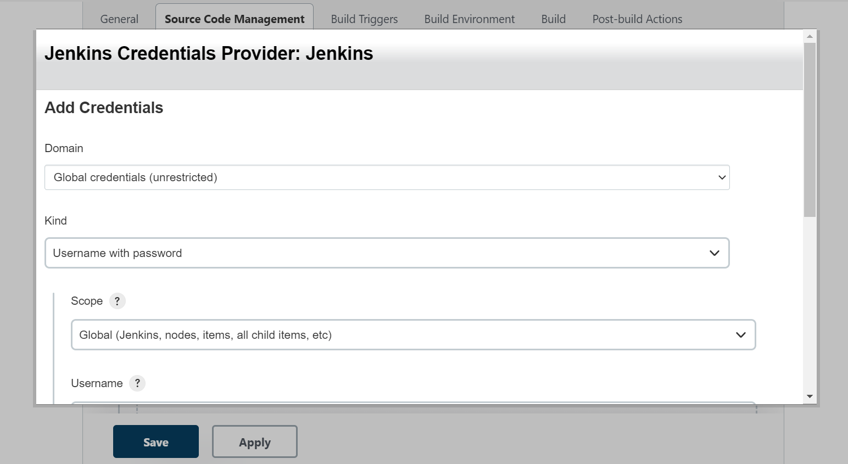

Slide 38
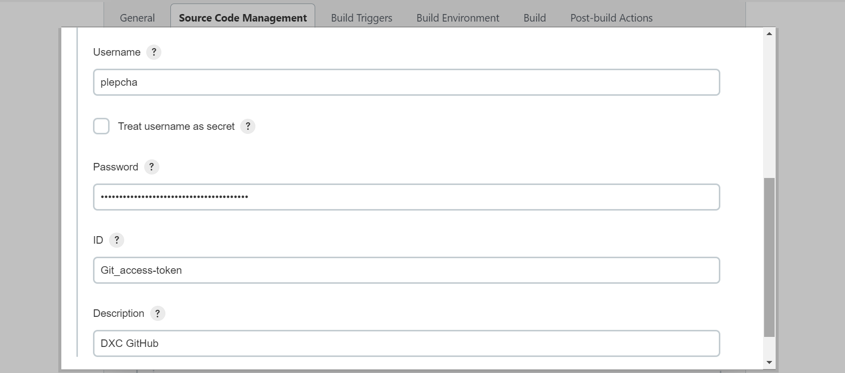
Add GitHub username and Personal access token (as mentioned in slide 13) in password

Slide 39
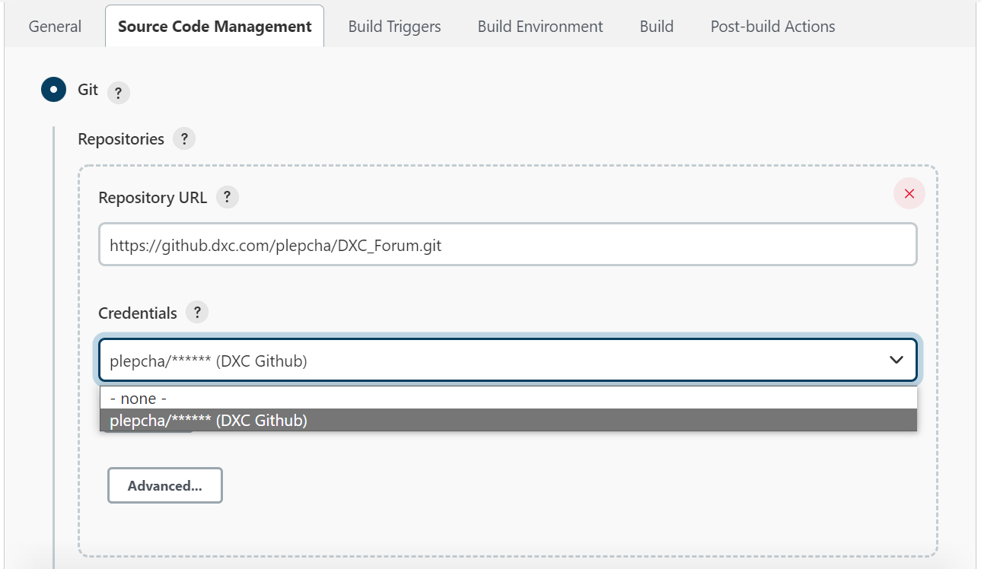
Select the URL and credentials to locate the source code repository

Slide 40
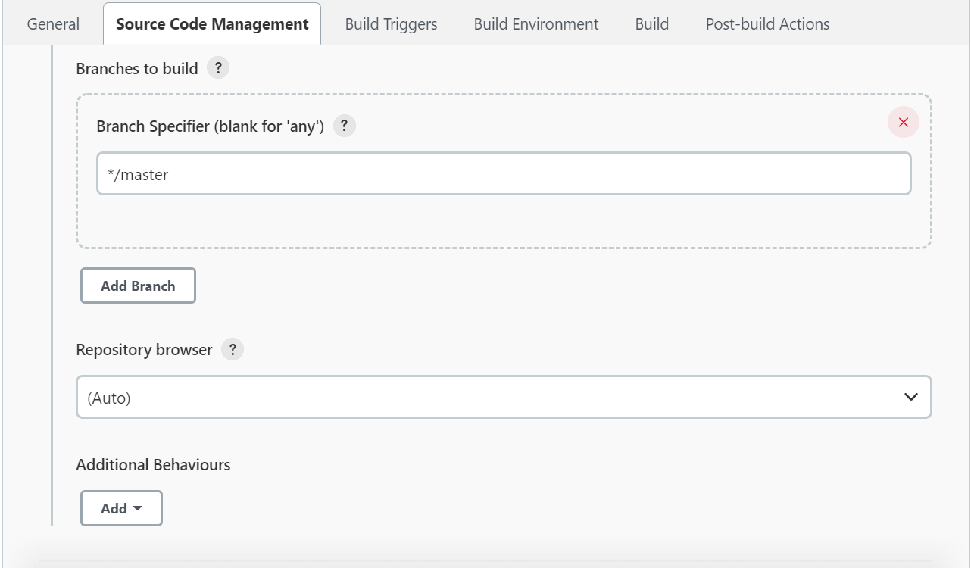
Select additional settings according to your project

Slide 41
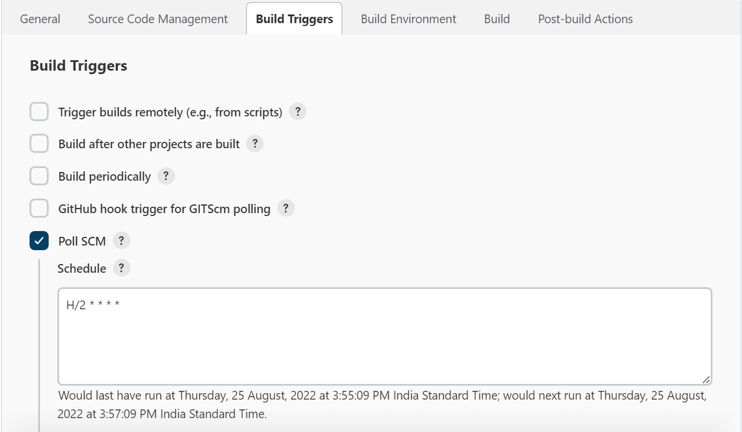
Select Poll SCM and use cron expression to schedule the build

Slide 42
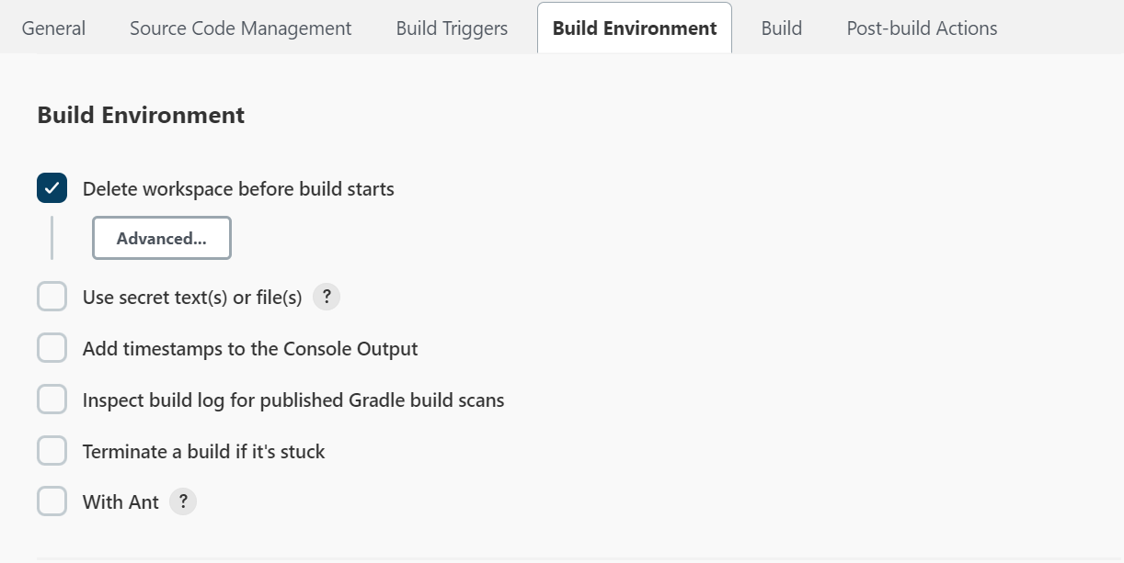
Deleting workspace before every build

Slide 43
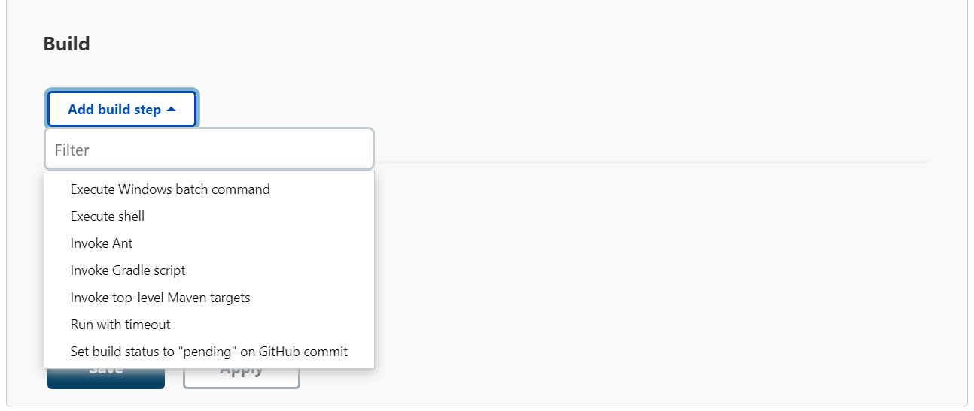
Select build step option according to the project

Slide 44
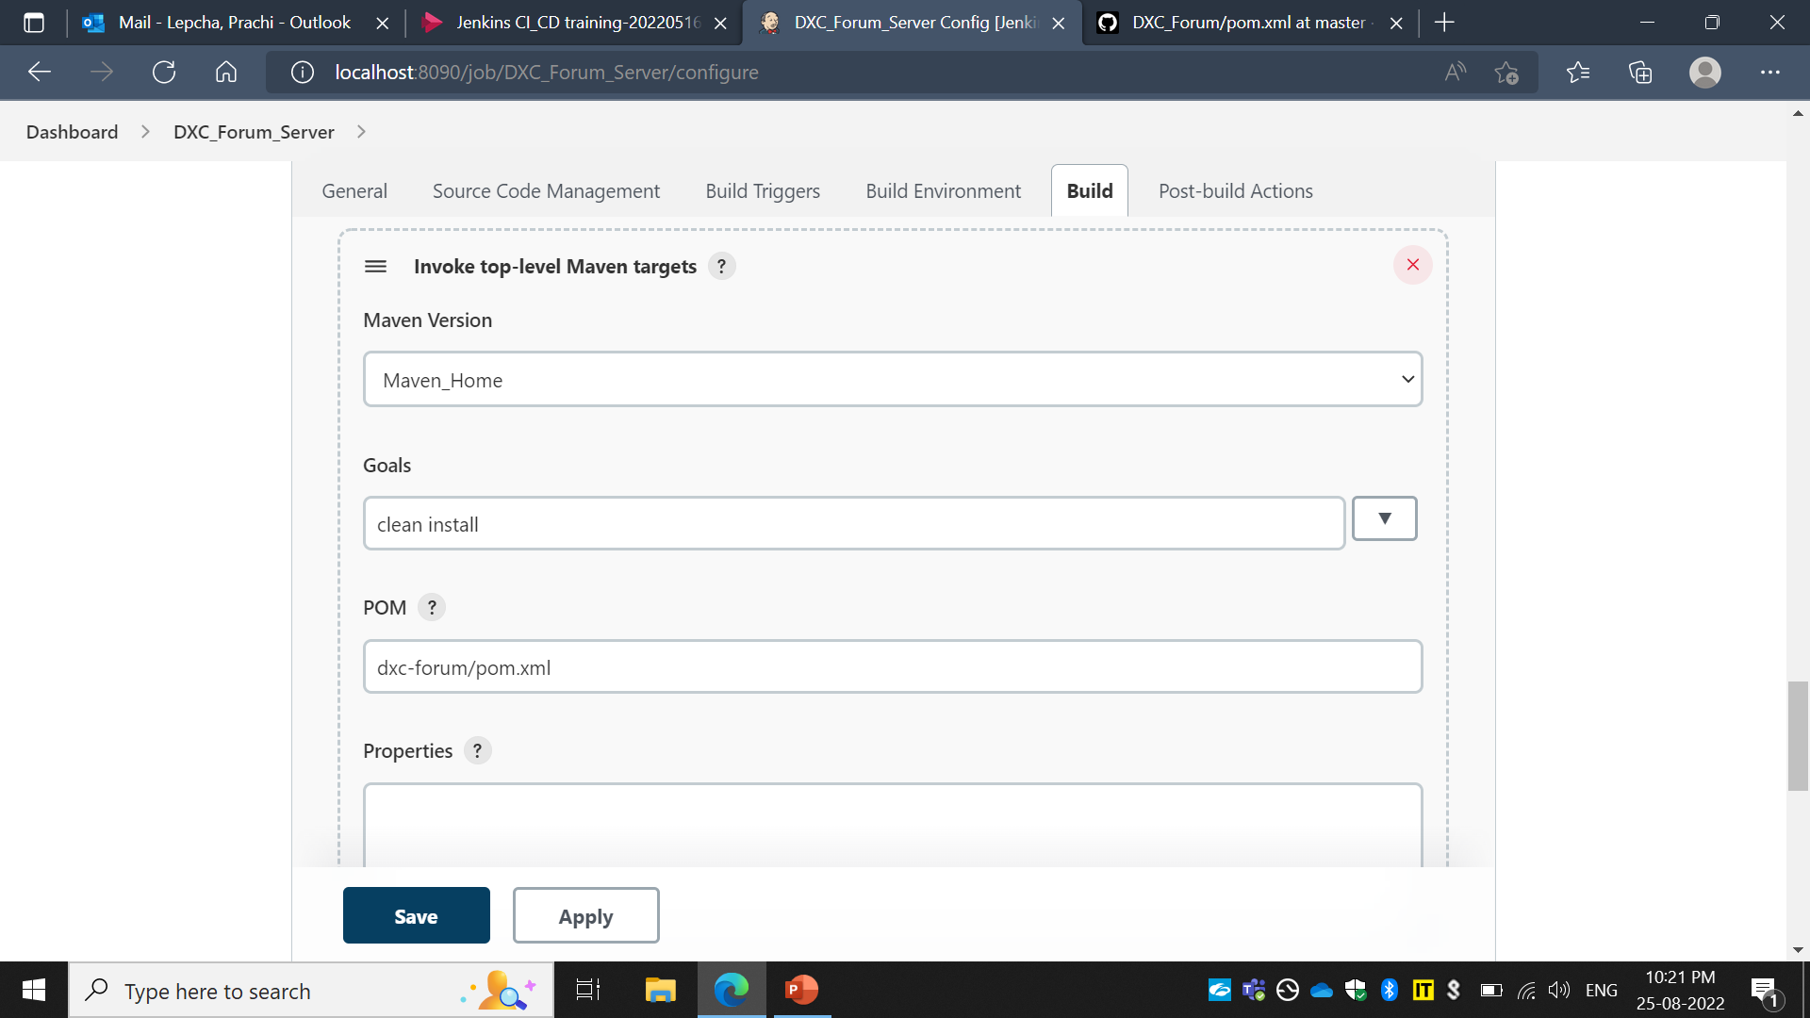


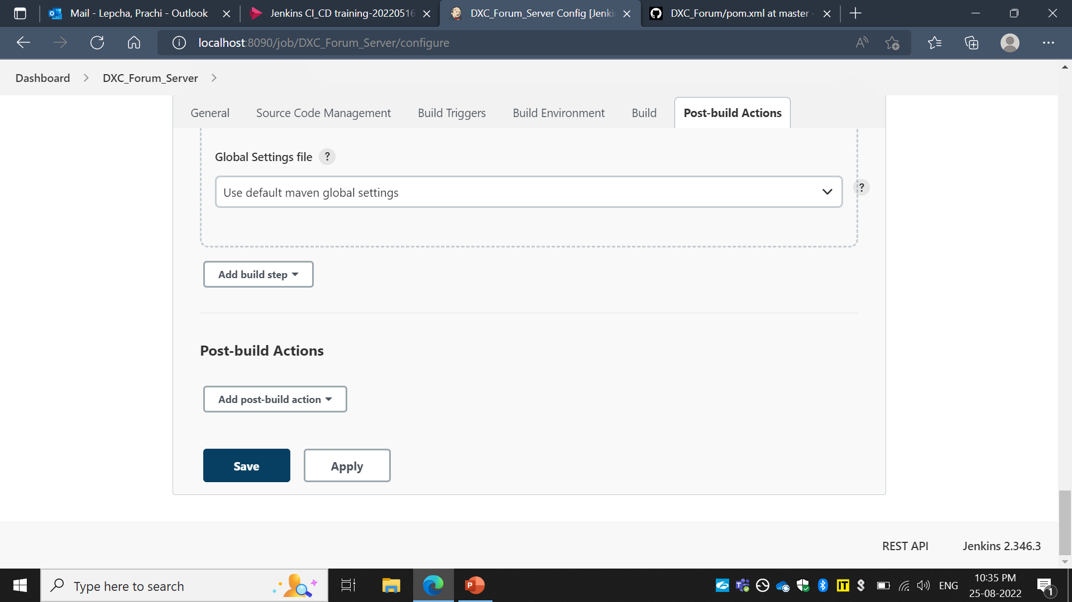
Select Maven version used for the project
Give the Maven commands and locate the pom.xml
Click Apply and Save

Slide 45
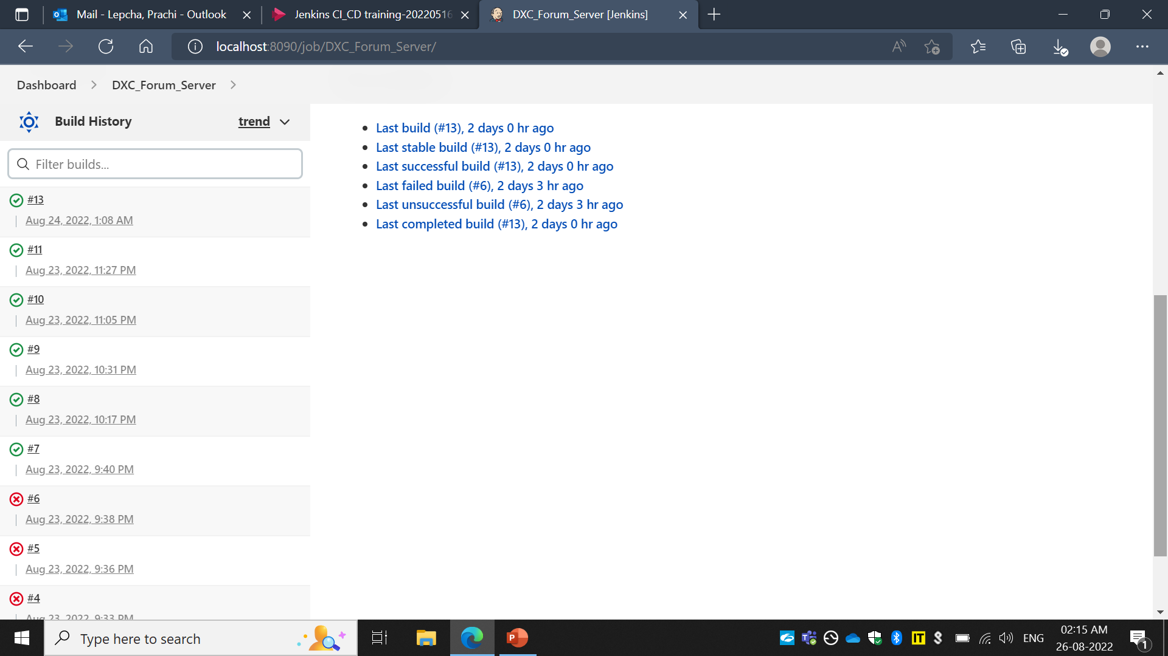

Check Build History. Click on Console Output to view the build run

Slide 46

SCM will trigger the build on the scheduled time
// Build triggered by SCM

Slide 47


User can trigger the build by clicking on Build Now
// Build triggered by the user

Slide 48

No errors will show the green tick with ‘Build Success’ in the console output

Slide 49

Similarly, specify the details for the front-end of your project
BUILD JOB FOR FRONT-END

Slide 50

Provide Git repository URL with same credentials

Slide 51

Schedule the build to be triggered

Slide 52


For front-end, click on Add build step to select suitable option for giving commands

Slide 53

Open Command Prompt Type echo %PATH% to check if NodeJs/npm is installed or is reflecting in the Path

Slide 54

If the path is not reflected in Command Prompt, you can set path in Jenkins’ Execute Windows batch command

Slide 55

Give commands to the Execute Windows batch command same as to the Command Prompt
Click Apply and Save

Slide 56

SCM will trigger the build on scheduled time
// Build triggered by SCM

Slide 57

Build job is successful

Slide 58
THANK YOU

